Slide 1




Ecological Restoration and Rehabilitation: Standards and Case Studies
Xuzhou International Forum on Green Urban Development
10th to 12th of June 2019
FROM EUROPE AND CHINA
Mendes A; Fabião A; Jihanua L; Zhang A; Xu F; Baiyinbaoligao; Ferreira T; Rabaça J
Notes:
Cover page

Slide 2
Summary of contents
Drivers of restoration in China
International definitions of restorations practices
Case Studies
On-line inquiry – results and future work
Definitions of restoration practices in Europe
Drivers of restoration in Europe
Global and Regional policy drivers of restoration

Slide 3
Global and Regional Policy Drivers of Restoration
Restoration
Convention for Biological Diversity
Convention on the Protection and Use of Transboundary Watercourses and International Lakes
Convention on International Trade of Endangered Species of Wild Flora and Fauna
Convention on Conservation of Migratory Species of Wild Animals
Convention on Wetlands of International Importance Especially as Waterfowl Habitat
UN Biodiversity Plan
Sustainable Development Goals
Restoration – UN next decade priority
Notes:
Lead to: Improved water protection in the EU; Development of a dynamic, world-leading water sector; Building block for the EU
to spark green and blue growth and become more resource efficient
In: http://www.ecrr.org/Publications/tabid/2624/mod/11083/articleType/ArticleView/articleId/3052/Default.aspx
A range European Directives or national legislation/ policies and implementation programmes have led to an actual demand for river restoration tools and techniques and these can generally be grouped into two categories:
1. Those which drive the delivery or river and catchment restoration, because restoration offers a means of meeting the objective of the Directive or policy
2. Those which support the delivery of river restoration (here highlighted in blue), through wider environmental improvements, such as water quality, without which a restoration project might fail.
Aditional Information about Water Framework Directive interactions with other legislative pieces in http://www.epa.ie/water/watmg/wfd/#.Vs1h77SYM_U:
The Water Framework Directive is linked to a number of other EU directives in several ways. These include Directives relating to the protection of biodiversity (Birds and Habitats Directives), directives related to specific uses of waters (drinking water, bathing waters and urban waste water directives) and to directives concerned with the regulation of activities undertaken in the environment (Industrial Emissions and Environmental Impact Assessment directives). More recent directives on topics such as Floods and the Marine Strategy Framework have significant linkages with the WFD which is also supplemented by the Priority Substances Directive and the Groundwater Directive. The Nitrates Directive forms an integral part of the Water Framework Directive and is one of the key instruments in the protection of waters against agricultural pressures. The Sustainable Use of Pesticides and the Sewage Sludge Directives also provide for the control of materials applied to land.

Slide 4
Drivers of Restoration in Europe
Restoration
Birds
Directive
Habitats
Directive
Water Framework Directive
Rural Development Programmes
Climate Change Adaptation Policy
Land Use Planning Policies
Floods
Directive
Nitrates Directive
Groundwater Directive
Common Agricultural Policy
In “Review of policy river restoration drivers in Europe” – European Centre for River Restoration -
Notes:
Implementation of the Water Framework Directive, 1st cycle 2009-2015: €300 billion
Construction, renewal and maintenance of urban water infrastructure: €90 billion annually
Research & Development: €9 billion
 Significant underinvestment in water
Lead to: Improved water protection in the EU; Development of a dynamic, world-leading water sector; Building block for the EU
to spark green and blue growth and become more resource efficient
In: http://www.ecrr.org/Publications/tabid/2624/mod/11083/articleType/ArticleView/articleId/3052/Default.aspx
A range European Directives or national legislation/ policies and implementation programmes have led to an actual demand for river restoration tools and techniques and these can generally be grouped into two categories:
1. Those which drive the delivery or river and catchment restoration, because restoration offers a means of meeting the objective of the Directive or policy
2. Those which support the delivery of river restoration (here highlighted in blue), through wider environmental improvements, such as water quality, without which a restoration project might fail.
Aditional Information about Water Framework Directive interactions with other legislative pieces in http://www.epa.ie/water/watmg/wfd/#.Vs1h77SYM_U:
The Water Framework Directive is linked to a number of other EU directives in several ways. These include Directives relating to the protection of biodiversity (Birds and Habitats Directives), directives related to specific uses of waters (drinking water, bathing waters and urban waste water directives) and to directives concerned with the regulation of activities undertaken in the environment (Industrial Emissions and Environmental Impact Assessment directives). More recent directives on topics such as Floods and the Marine Strategy Framework have significant linkages with the WFD which is also supplemented by the Priority Substances Directive and the Groundwater Directive. The Nitrates Directive forms an integral part of the Water Framework Directive and is one of the key instruments in the protection of waters against agricultural pressures. The Sustainable Use of Pesticides and the Sewage Sludge Directives also provide for the control of materials applied to land.

Slide 5
Drivers of Restoration in China
Restoration
National Comprehensive Plan on Water Resources
2010-2030
River and Lake Chief System
Water Law of PRC
1988 (2016)
Promoting the Development of Ecological Civilization (2015)
Water Pollution Prevention and Control Action Plan
2015
The new Environmental Protection Law (2015)
Three Red Lines of Most Stringent Water Resources Management (2012)

Slide 6
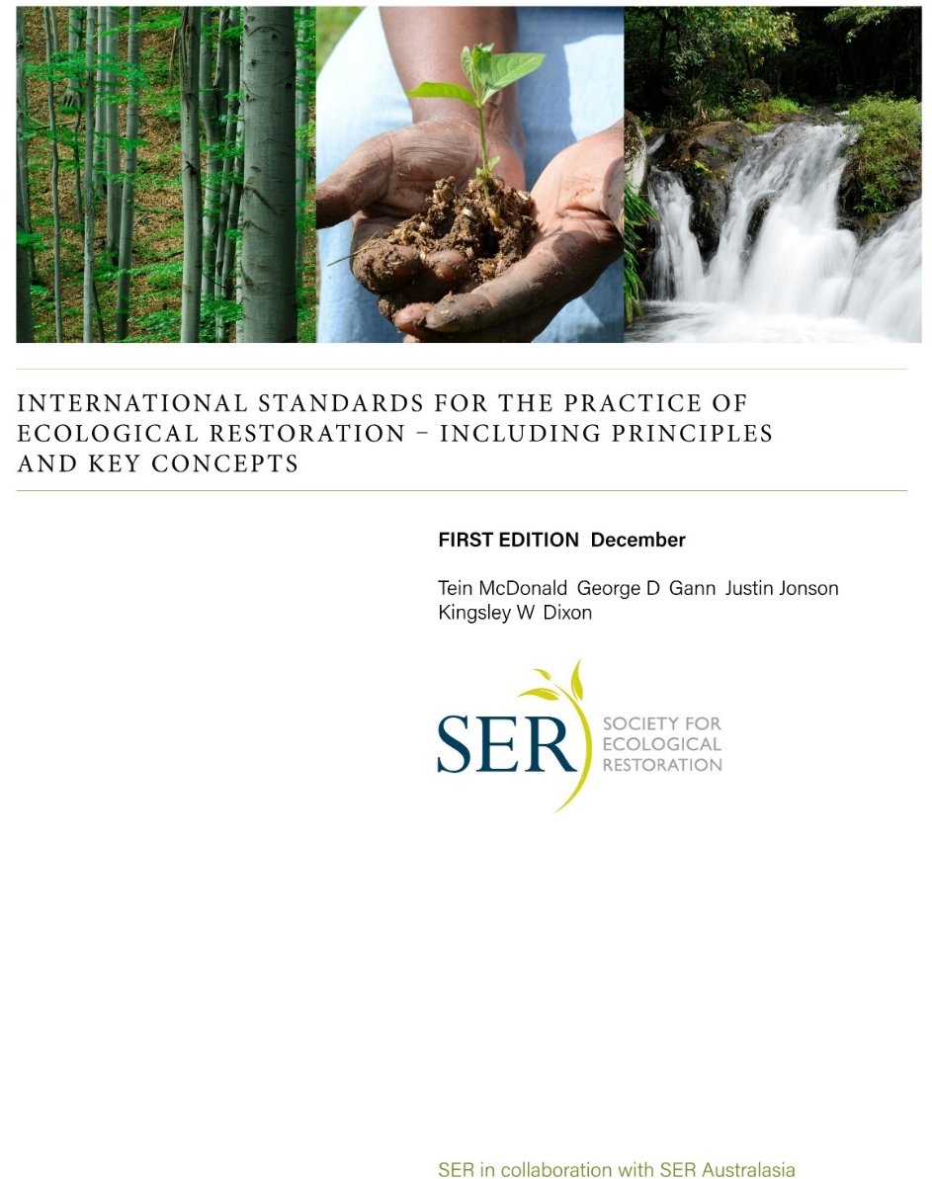
International definitions of restorations practices
“Ecological restoration is the process of assisting the recovery of an ecosystem that has been degraded, damaged or detroyed” (Society for Ecological Restoration, 2004)
McDonald, T., Gann, G.D., Jonson, J., Dixon, K.W. 2016. International Standards for the Practice of Ecological Restoration - Including Principles and Key Concepts. First Edition. Society for Ecological Restoration, Washington D.C.
Free download at:
http://www.ser.org/?page=SERStandards

Slide 7
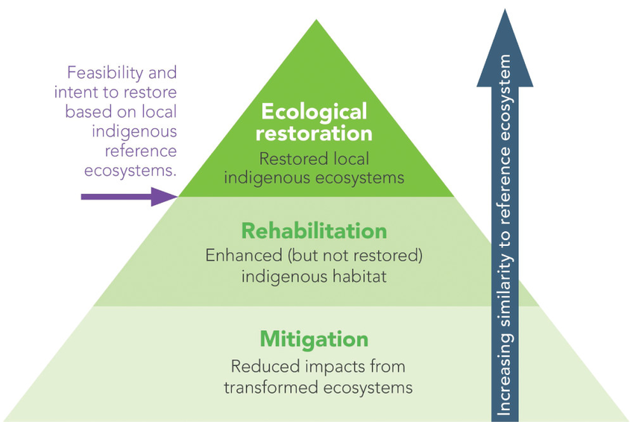
SER standards consider 3 levels of ecological restoration:
Full recovery: key ecosystem attributes similar to those of the reference ecosystem.
Partial recovery: ecosystem attributes have improved but do not closely resemble those of the reference ecosystem.
Ecosystem maintenance: activities applied after full recovery to stop processes of ecological degradation.
Adapted from McDonald, T., Jonson, J., Dixon, K.W. 2016. National standards for the practice of ecological restoration in Australia. Restoration Ecology 24:S4-S32. DOI: 10.1111/rec.12359
Notes:
Restore: to recover the natural composition, structure, processes and functions of a river, thereby allowing it to once again achieve full integrity and preserve its self-regulated dynamic balance
Rehabilitate: to recover the composition, structure, processes and functions that are as close as possible to the river’s natural conditions (reference scenario…)
Mitigate: to achieve a status that is significantly different from river’s natural state, but reaches a compromise with the inevitable limitations which the river is subjected.

Slide 8
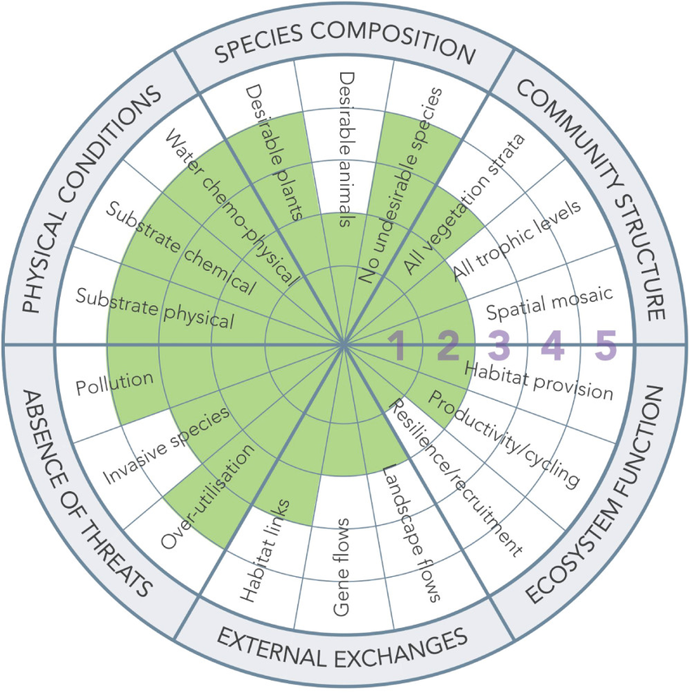
SER Five star classification system helps to track progress towards project goals over time. It uses six key ecosystem attributes to measure progress towards full restoration:
Species composition
Structural diversity (=Community structure)
Ecosystem function
External Exchanges
Absence of threats
Physical conditions
Source: McDonald, T., Jonson, J., Dixon, K.W. 2016. National standards for the practice of ecological restoration in Australia. Restoration Ecology 24:S4-S32. DOI: 10.1111/rec.12359

Slide 9
Definitions of Restoration in Europe
Restore: to recover the natural composition, struture, processes and functions of a river, thereby allowing it to once again achieve full integrity and preserve its self-regulated dynamic balance
Rehabilitate: to recover the compostion, struture, processes and functions that are as close as possible to the river’s natural conditions (reference scenario…)
Mitigate: to achive a status that is significantly different from river’s natural state, but reaches a compromise with the inevitable limitations which the river is subjected.

Slide 10
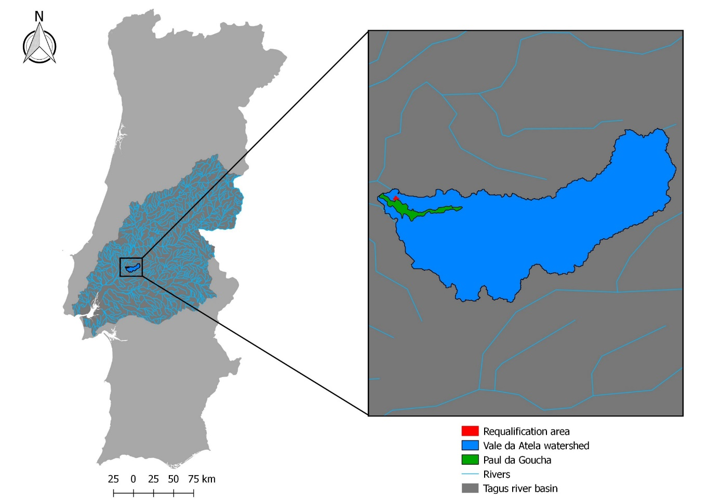
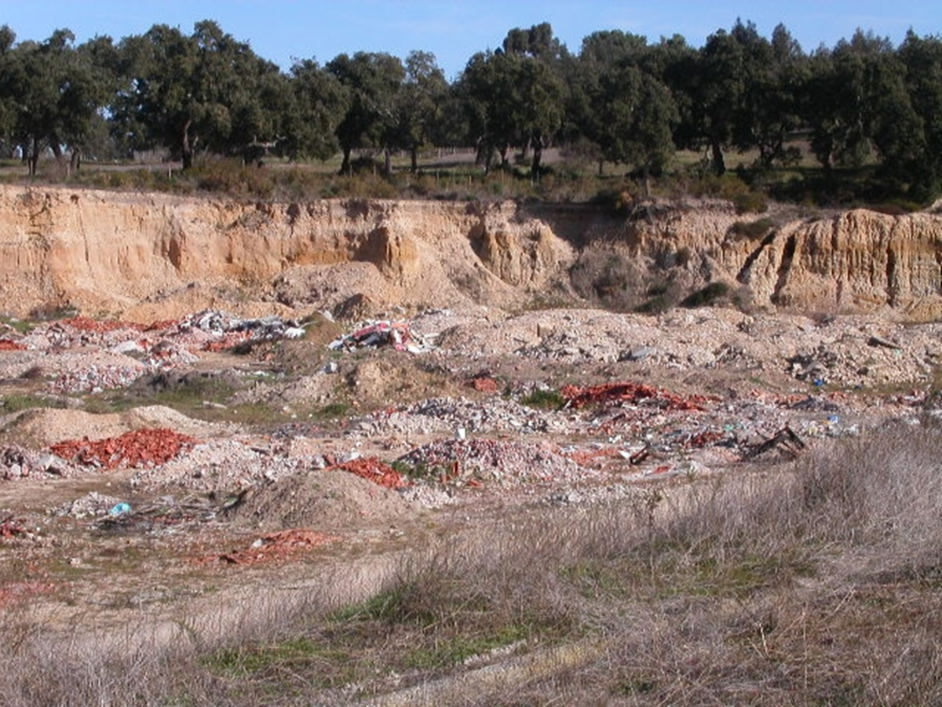
CASE STUDY – PAUL DA GOUCHA, PORTUGAL
ENVIRONMENTAL REHABILITATION
TRIGGER / IMPROVE NATURAL RIPARIAN VEGETATION COLONIZATION
REHABILITATE THE FEEDING, NESTING AND RESTING AREA FOR BIRDS
ENVIRONMENTAL EDUCATION
Notes:
TARGET: restoration of a willow dominated wetland
GOALS: multi strata, resilient, native wetland woodland; improve bird habitat; environmental education
OBJECTIVES: cessation of litter dumping in 1 year; reduce abundance of invasive plants; trigger / improve natural riparian vegetation colonization; restore the feeding, nesting and resting area for birds

Slide 11
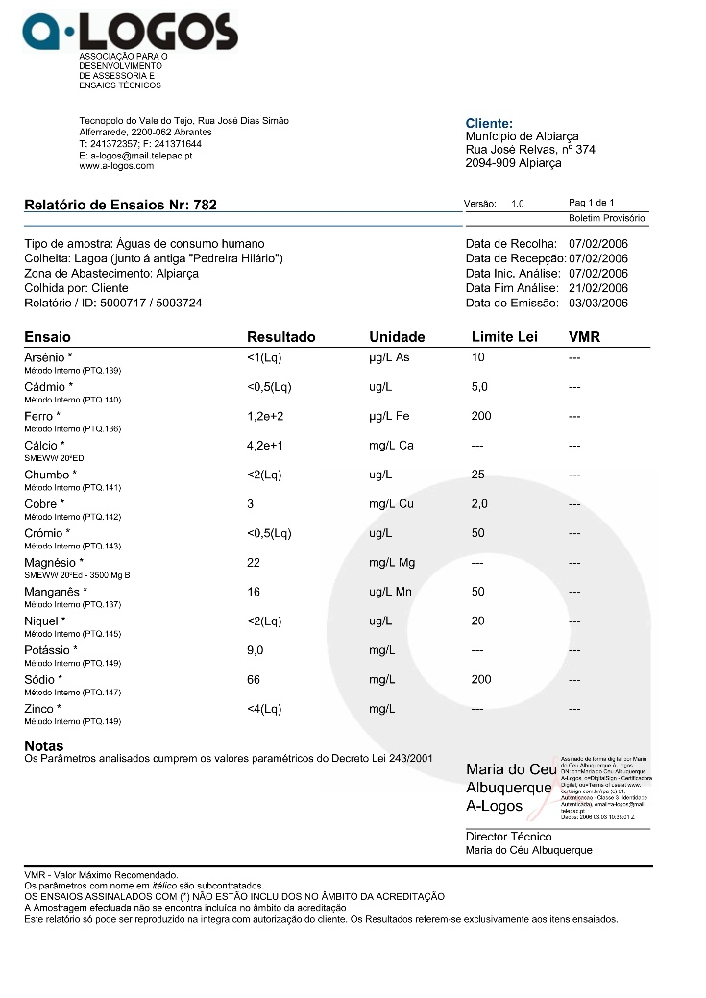
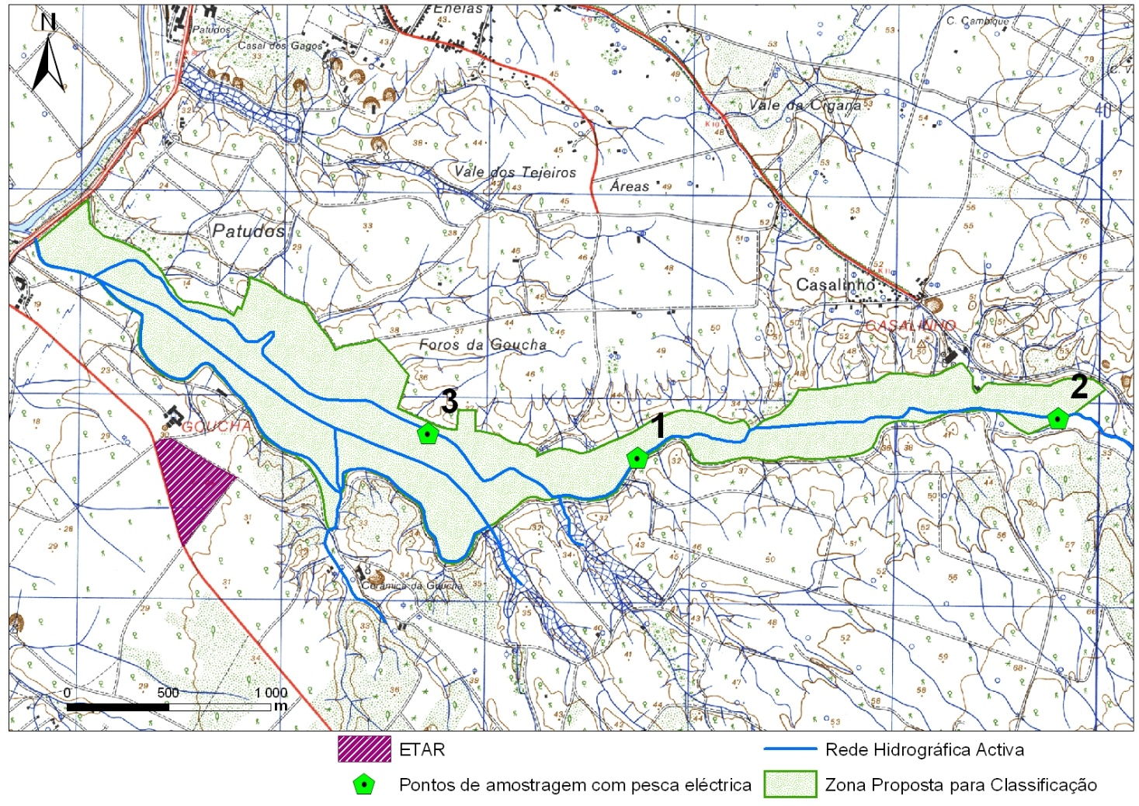
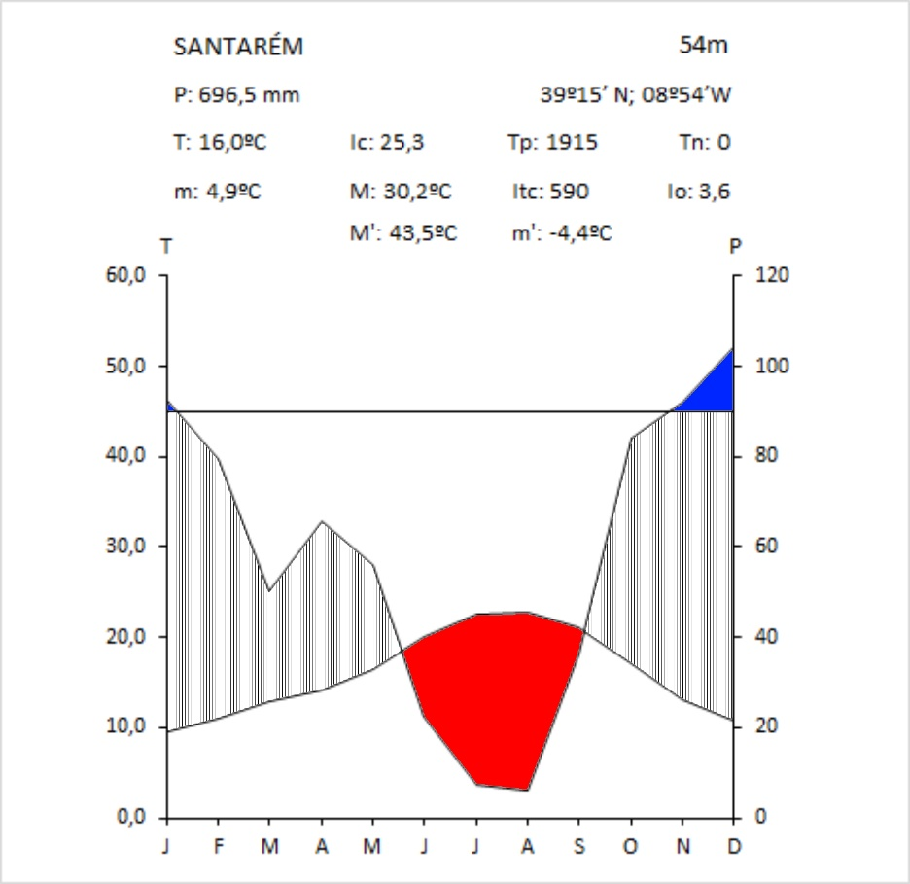
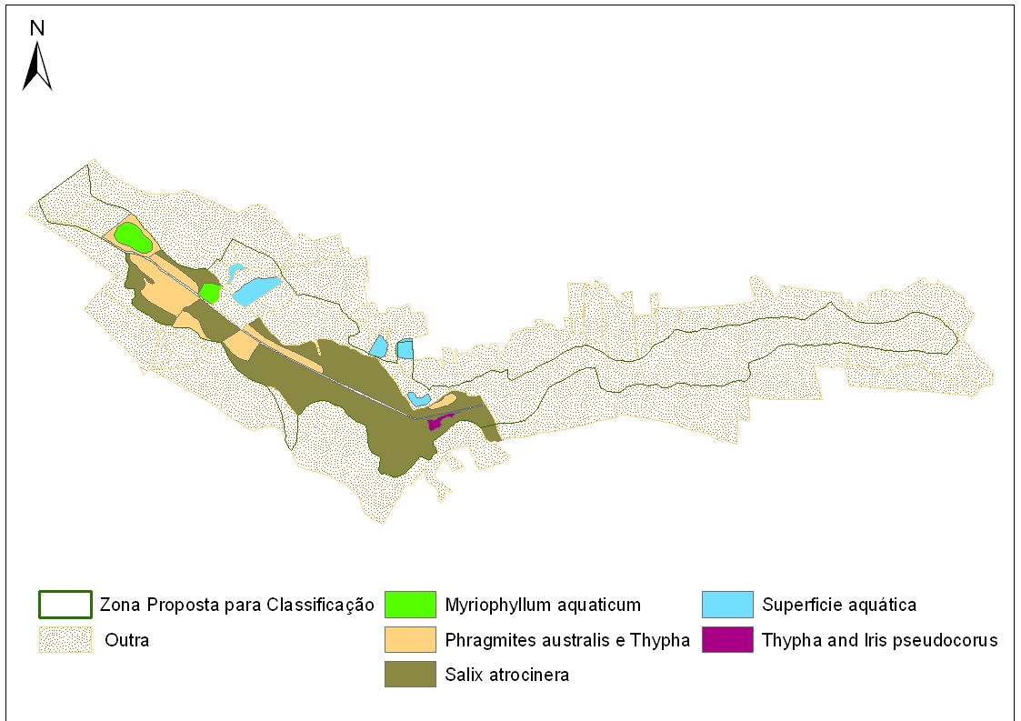
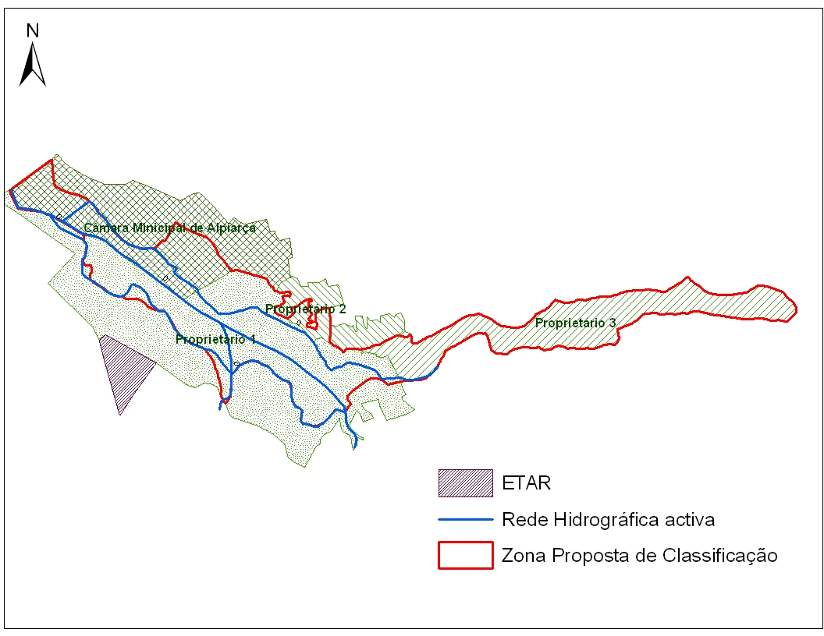
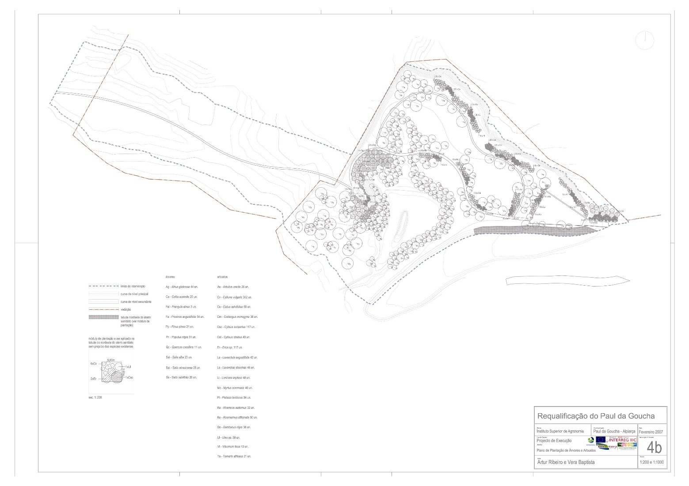
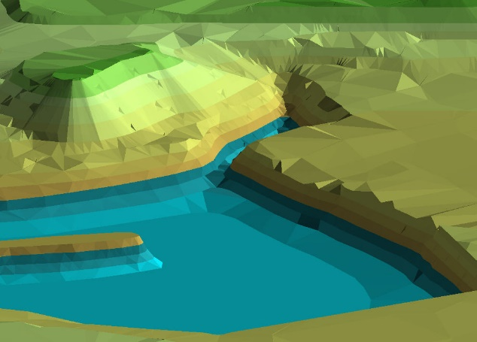

PLANNING
AND
DESIGN

Slide 12
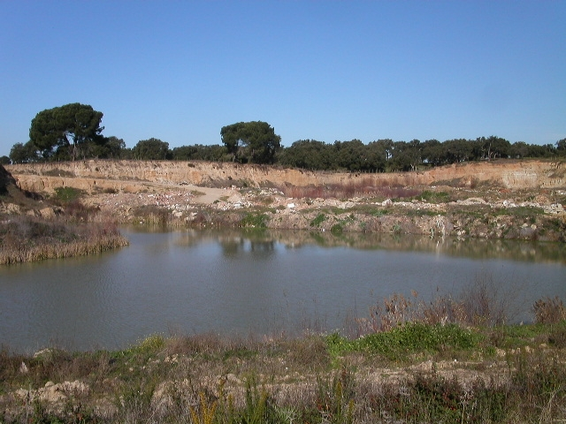
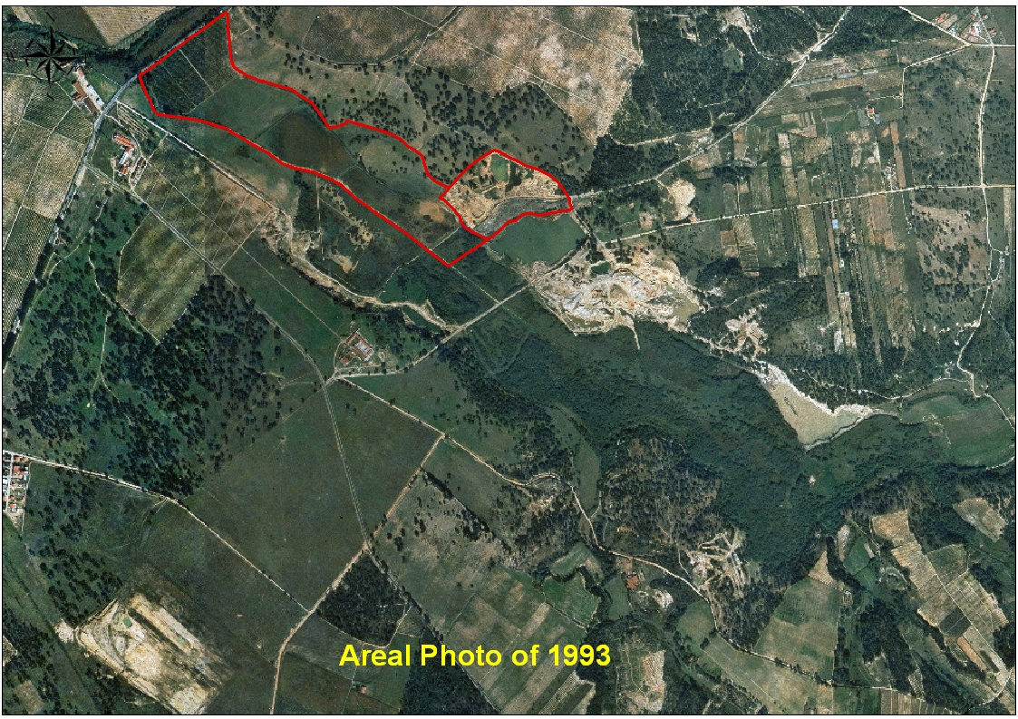
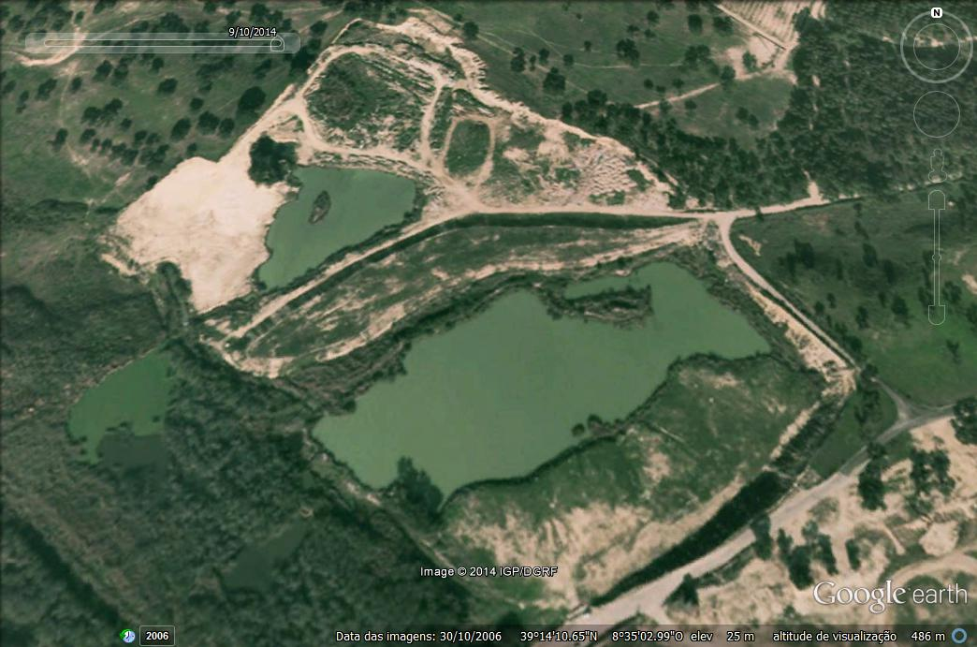

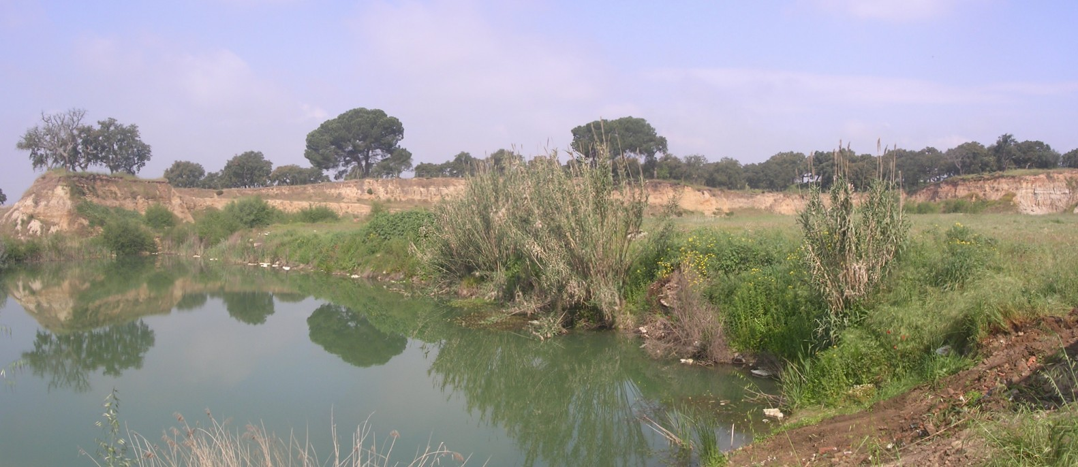
Case Study – Alpiarça - Portugal
1993

Slide 13
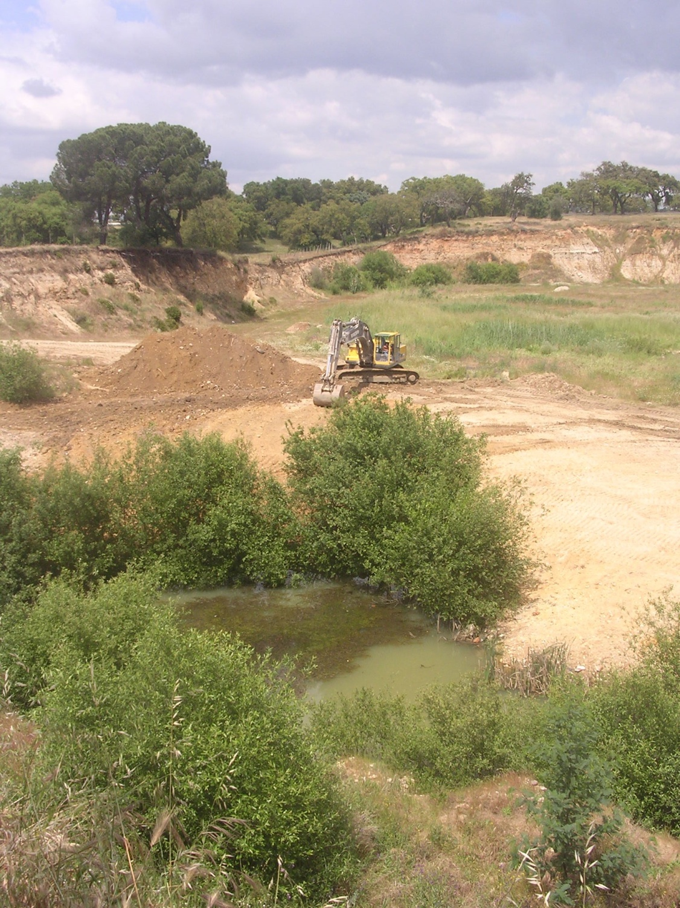
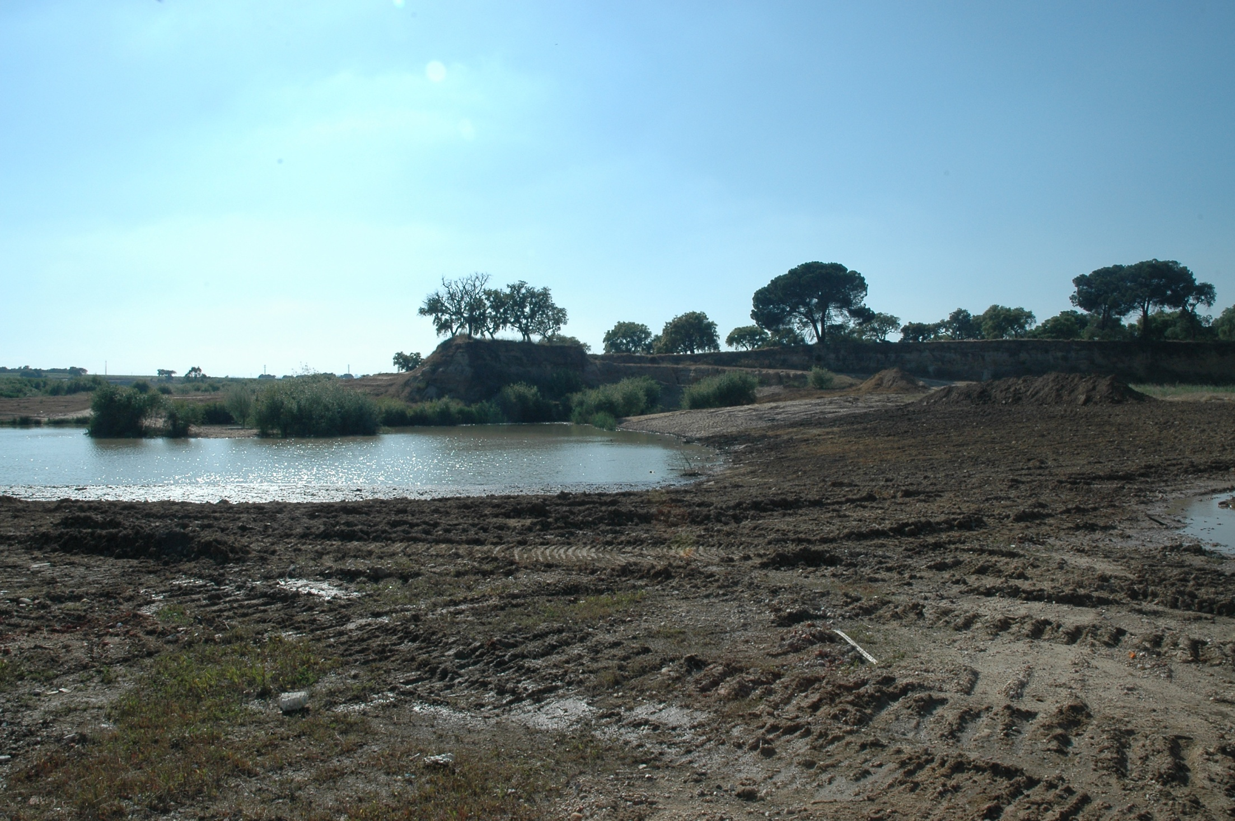
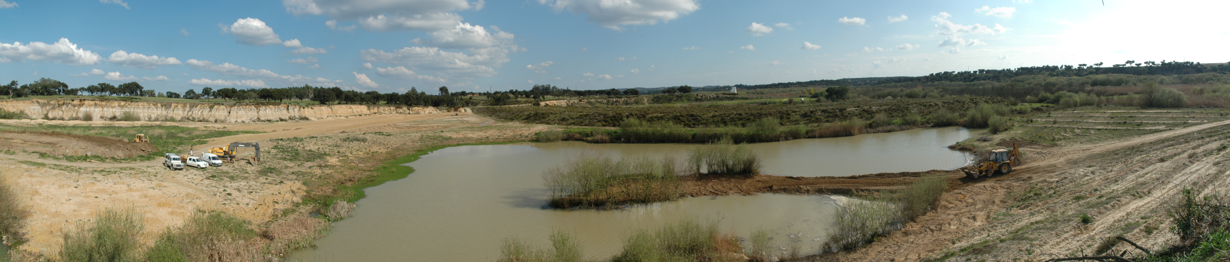
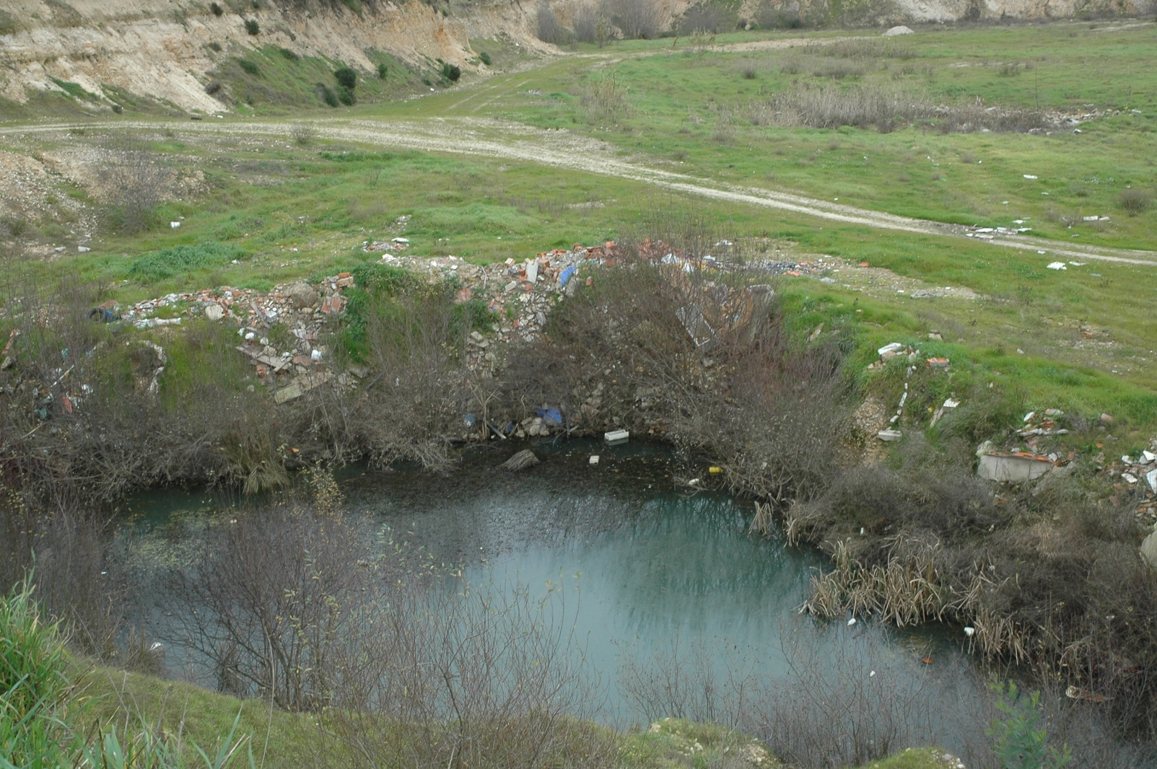
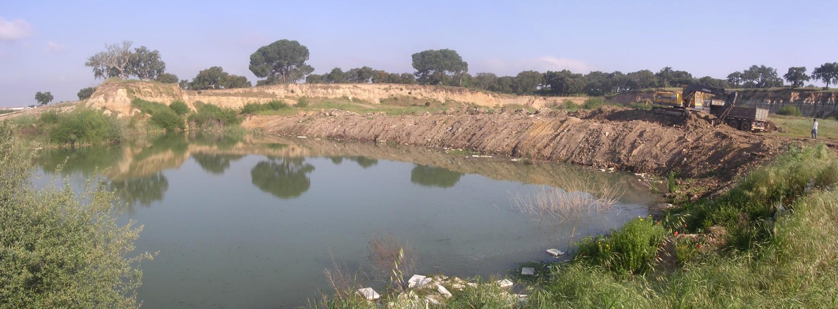
Developed activities -
Direct Cost: 44 893€
Debris clean-up and soil reprofiling

Slide 14
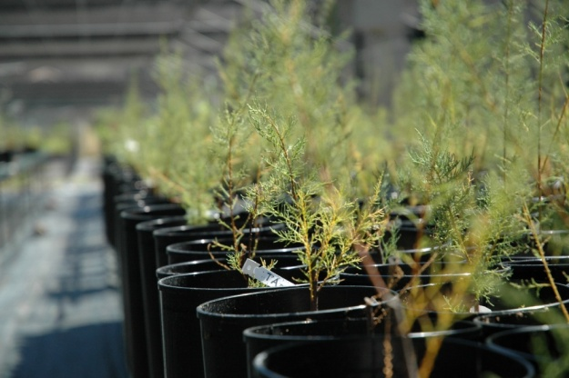
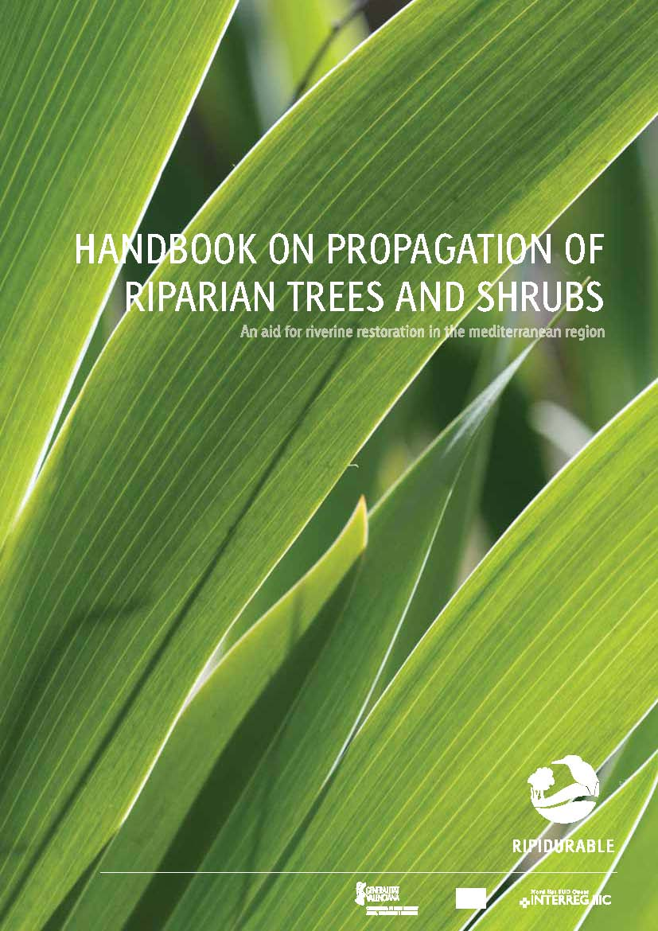
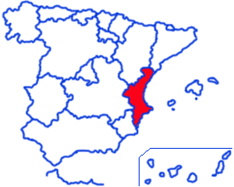
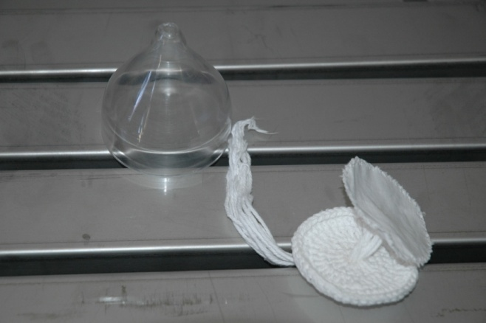
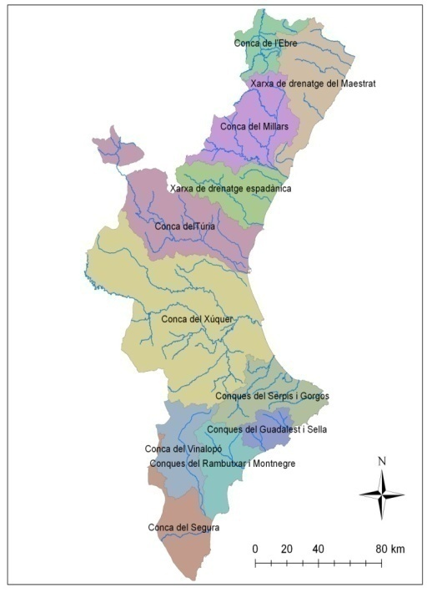
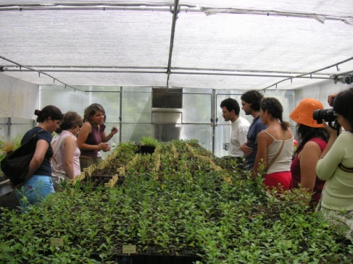
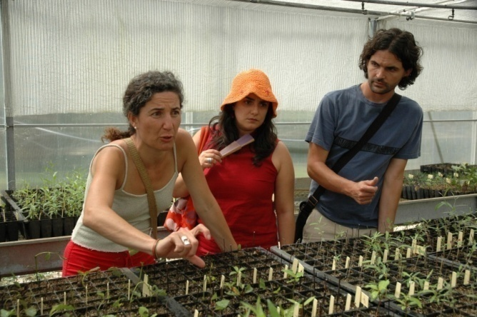
Native Plant Propagation
The lack of suitable plant material from the same geographic region for pilot restoration projects was addressed

Slide 15
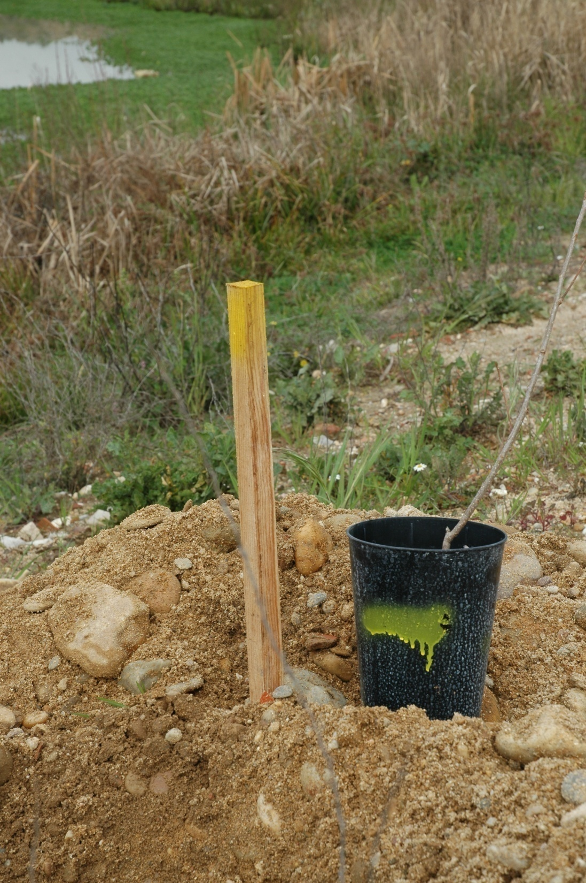
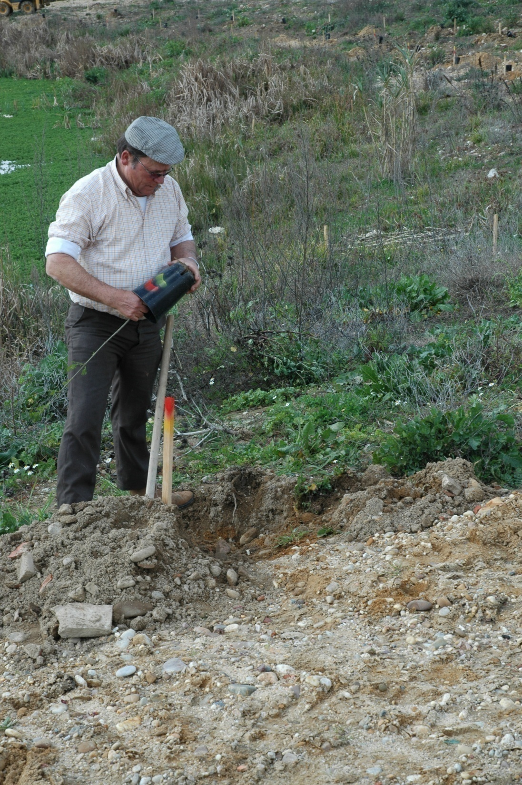
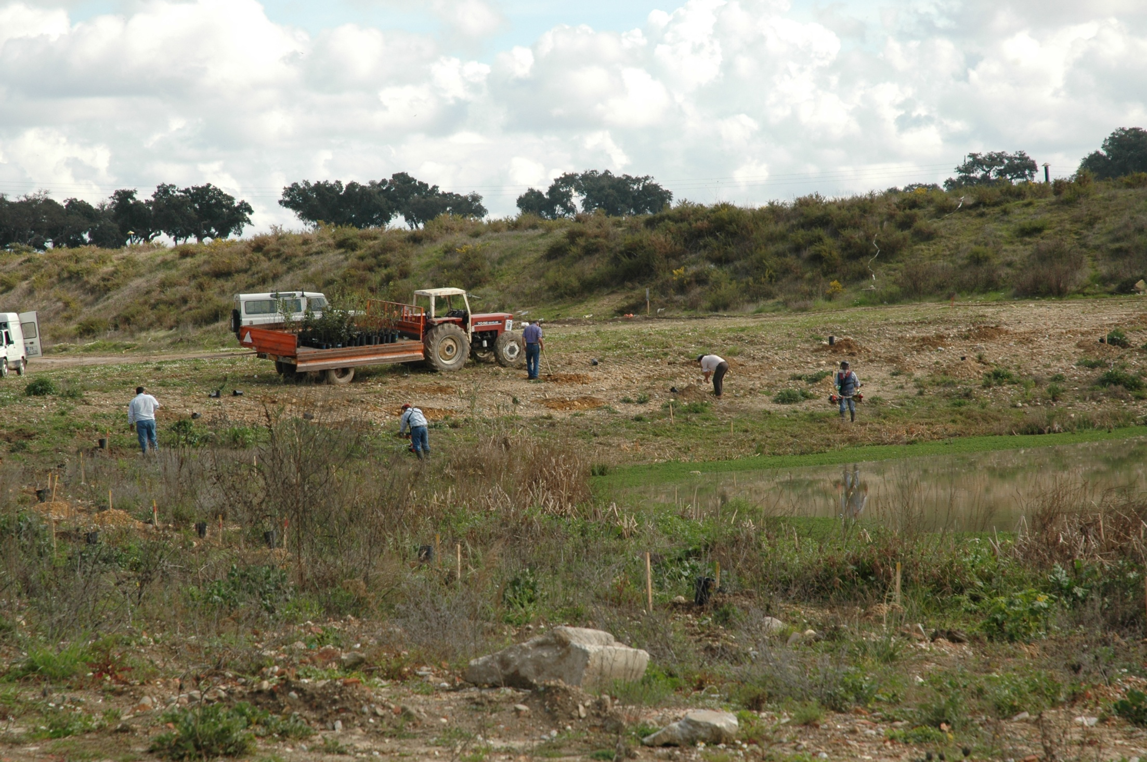
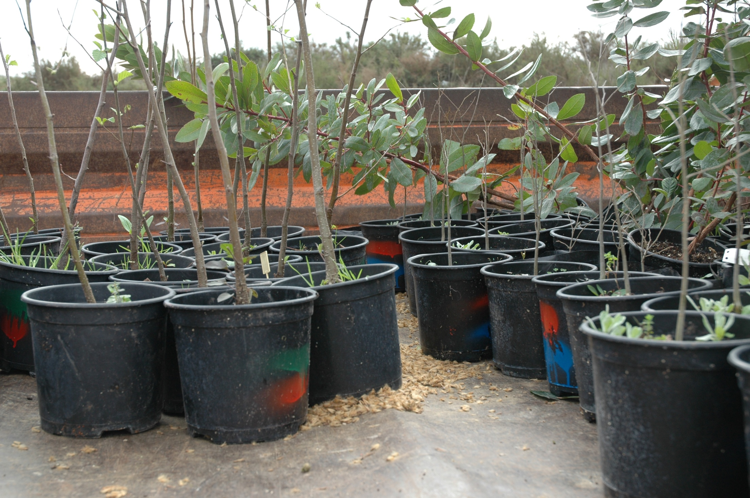
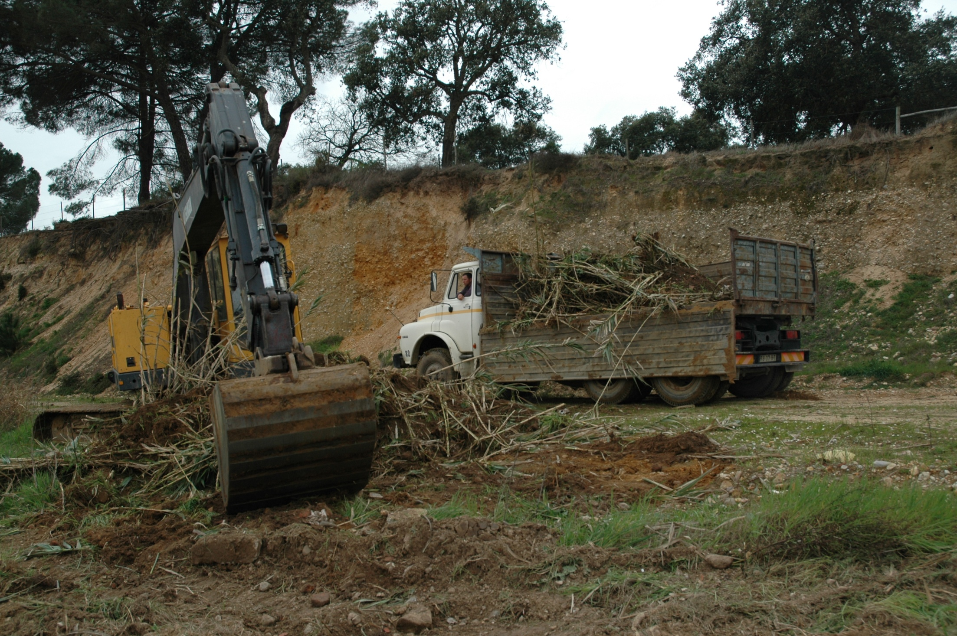
Developed activities
Total Cost: 44 893€
February 2008
Exotic species removal (Arundo donax)
Tree and shrub plantation

Slide 16
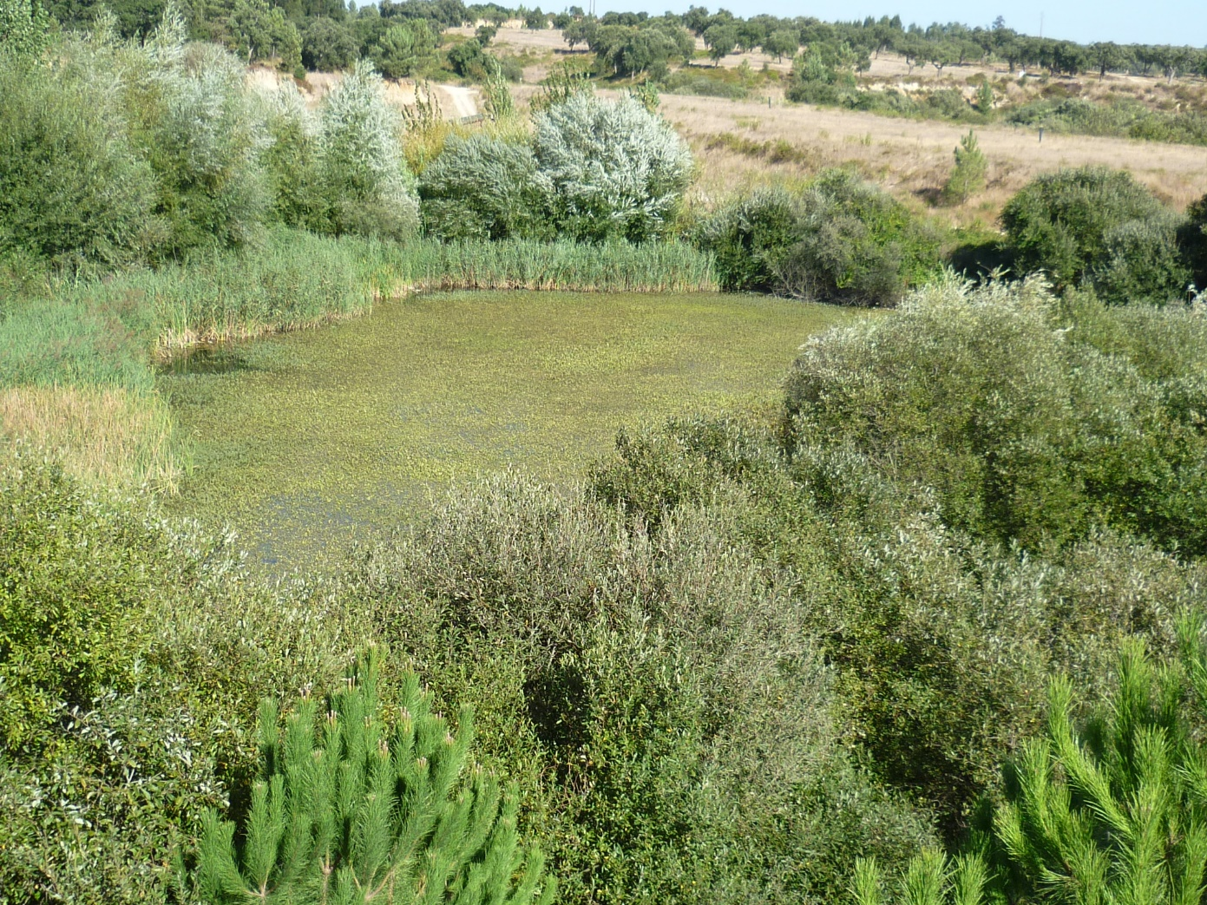
MONITORING
Global average survival after 9 years was 70% (stolen plants were recorded, but counted as dead).
About 7% of the plants were stolen with Populus nigra (23% of the plants stolen) and Arbutus unedo (17% stolen) being the the most attractive for robbers.
CEWP Workshop on River Restoration, 6-7 February 2018, Beijing

Slide 17
MONITORING
Most of the highest values observed 9 years after planting account for natural regeneration from the seed bank and adjacent reproductive tree sources.
Populus nigra presented the highest average DBH (27.2±2.0 cm), followed by Alnus glutinosa (16.1±1.7 cm) and Salix alba (15.5±1.3 cm).
CEWP Workshop on River Restoration, 6-7 February 2018, Beijing
Frequency histogram with DBH class distribution 9 years after plantation
Notes:
Global DBH class distribution after 9 years shows a gradual frequency reduction from the lower class to the higher class, i. e., a DBH distribution close to that typical of a unevenaged, multicohort stand with natural regeneration

Slide 18
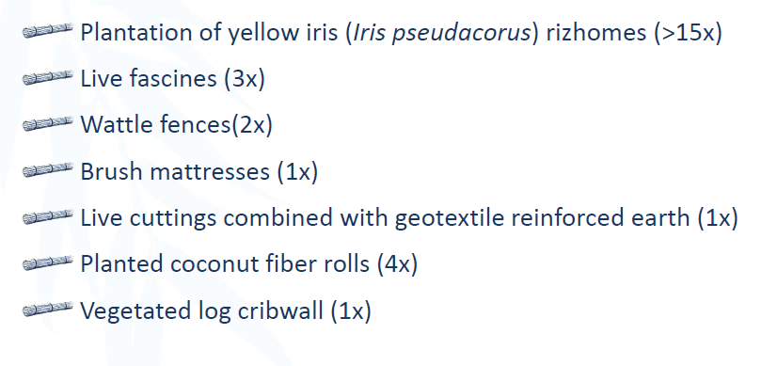
Bioengineering Techniques

Slide 19
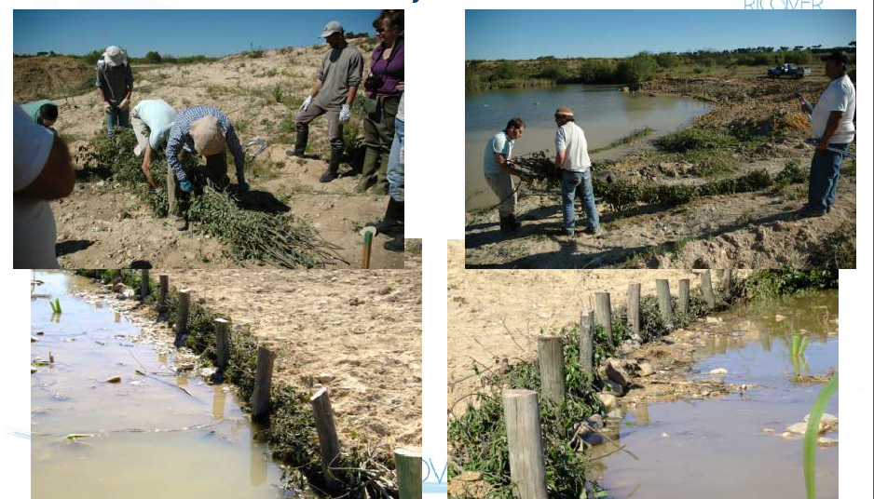
Live fascines

Slide 20
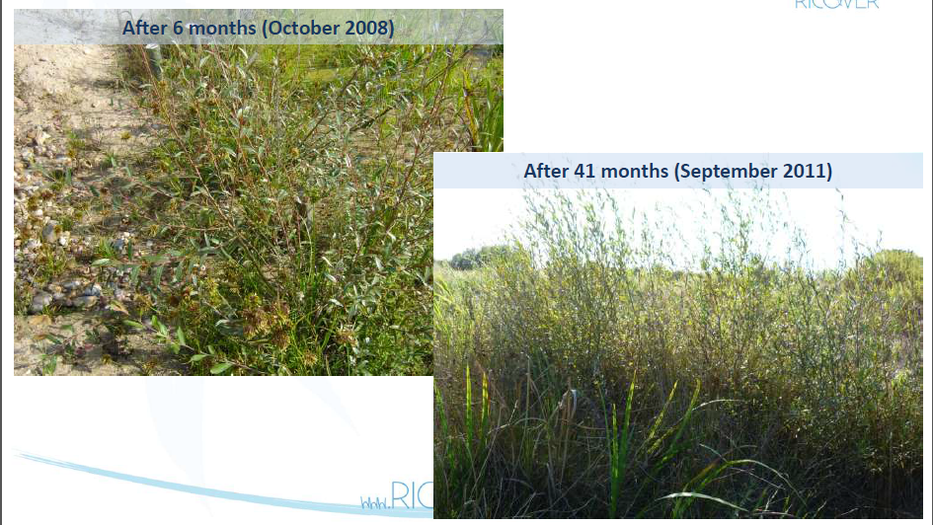
Live fascines

Slide 21
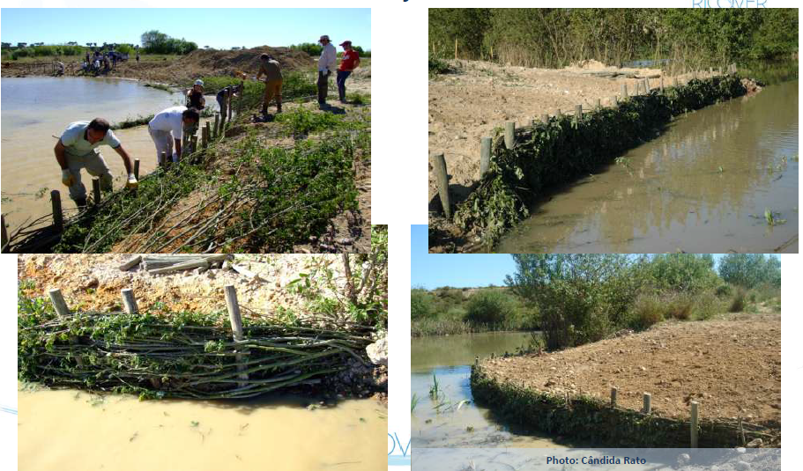
Wattle fences

Slide 22
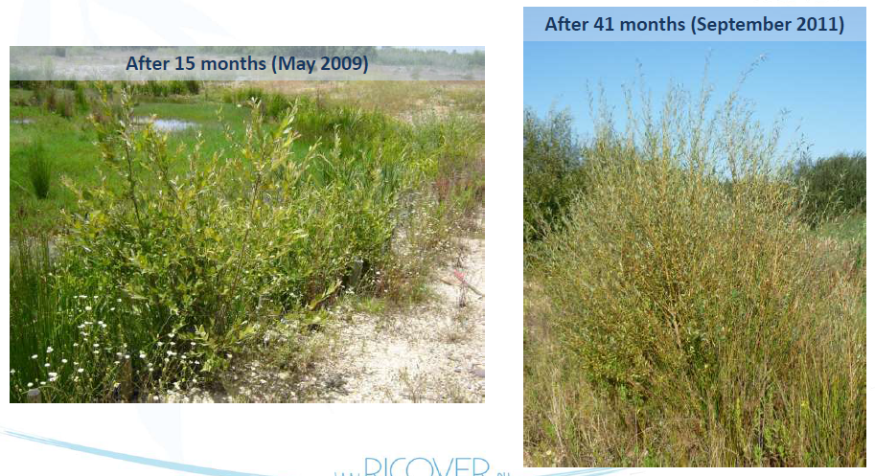
Wattle fences

Slide 23
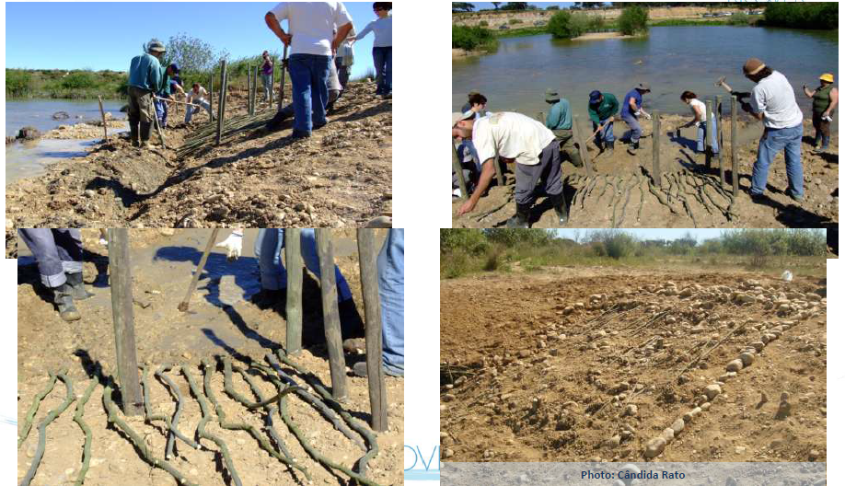
Brush mattresses

Slide 24
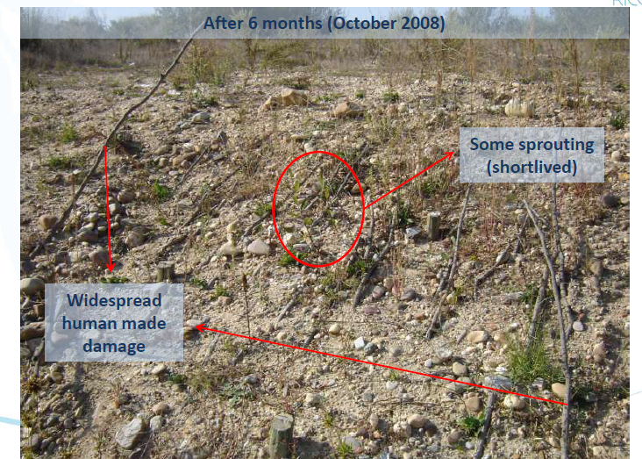
Brush mattresses

Slide 25
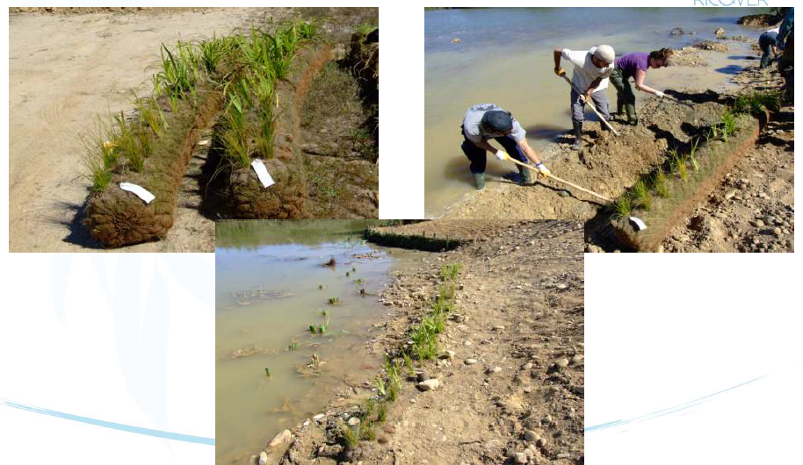
Planted coconut fiber rolls

Slide 26
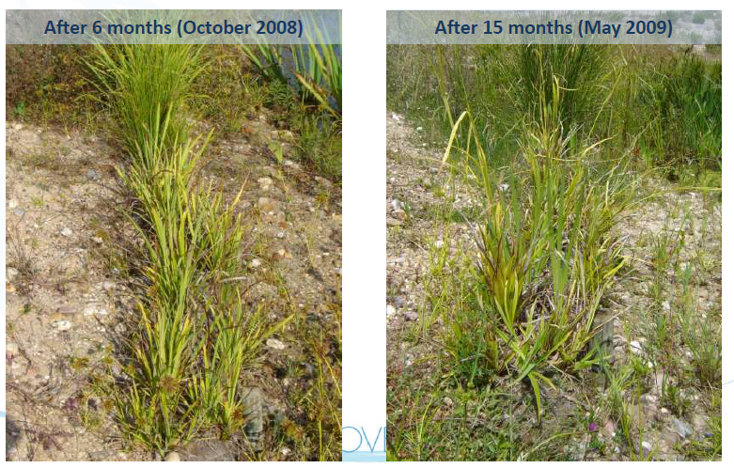
Planted coconut fiber rolls

Slide 27
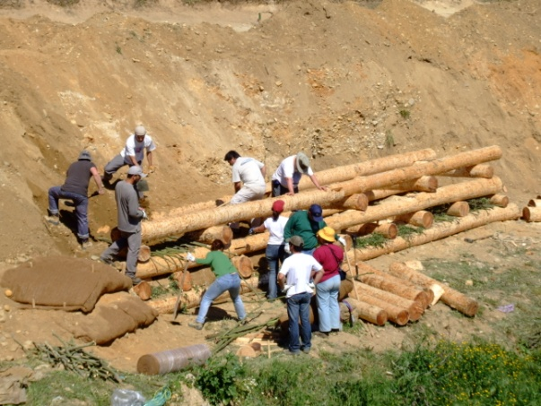
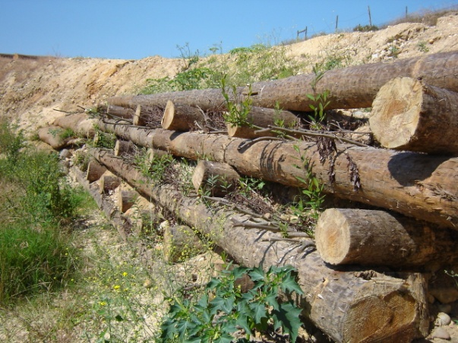
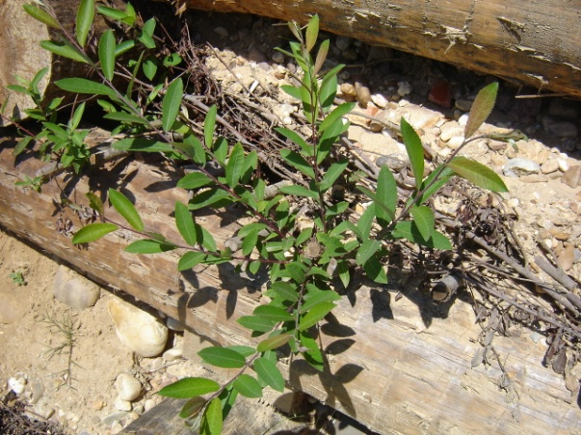

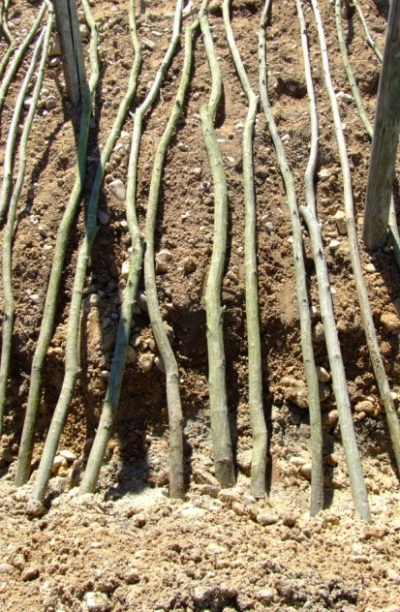
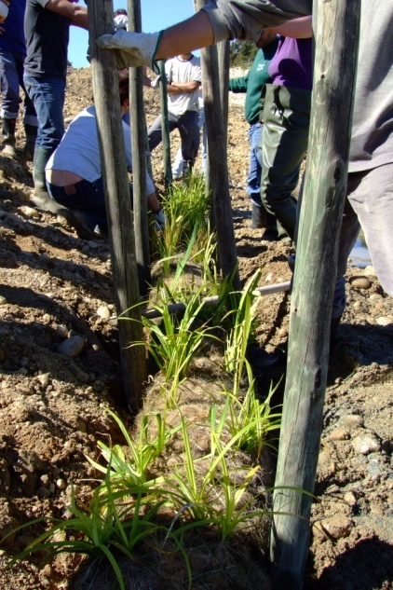

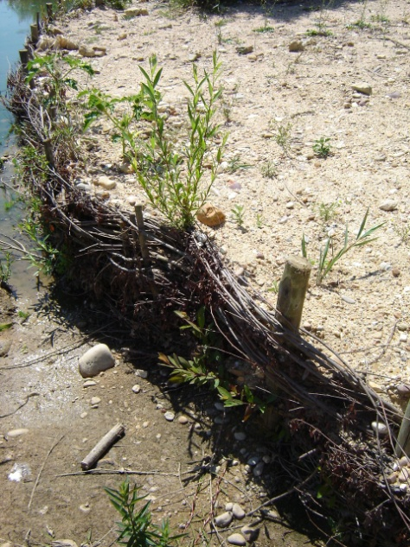
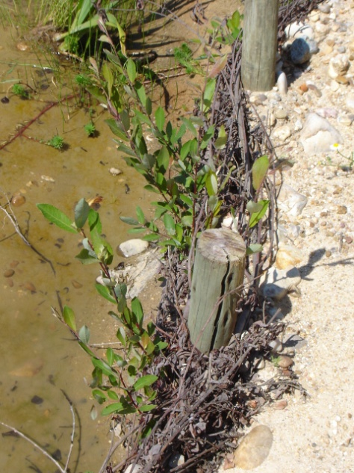

CEWP Workshop on River Restoration, 6-7 February 2018, Beijing
MONITORING - SOIL BIOENGINEERING
Poles and live cuttings of Salix atrocinerea collected on the undisturbed sections of the Paul da Goucha
Variable success, related mainly to the proximity to water and the use of live cuttings instead of rooted plants in the driest locations.
A
B
C
D
E
F
G
A, B e C: Cribwall
D: Brush mattress
E: planted coconut fiber rolls
F: Wattle fences
G: Live fascines

Slide 28


EVALUATION
2008, after 6 months
2017, after 9 years
★★★☆☆
Adjacent threats being managed or mitigated and very low threat from undesirable species onsite. A moderate subset of characteristic native species are established and some evidence of ecosystem functionality commencing. Improved connectivity in evidence.
http://seraustralasia.com/wheel/wheel.html

Slide 29


FEBRUARY 2008
SEPTEMBER 2011
AUGUST 2014

Slide 30

中欧水平台环境修复项目问卷调研
CEWP Restoration projects inquiry
In the context of China Europe Water Platform, the University of Évora, the China Institute of Water Resources and Hydro-power Research and Tongji University are promoting an on-line inquiry to make an evaluation of restoration projects developed in Europe and China, with the objective of contributing to increase restoration standards. By answering to this questionnaire, you will be contributing to a policy study that wishes to give support to European and Chinese policy makers on the most appropriate restoration standards to use when developing this type of project. The inquiry is targeted to restoration projects implemented in freshwater ecosystems.
https://pt.surveymonkey.com/r/8XYGB36

Slide 31


Impact of policy on restoration projects
Europe
China

Slide 32
3 Star
4 Star
2 Star
Absence of Threats
Physical Conditions
Species composition
Strutural composition
Ecosystem function
External Exchanges
Notes:
Example how to present some statistics or numerical facts.

Slide 33
3 Star
2 Star
1 Star
Absence of Threats
Physical Conditions
Species composition
Strutural Diversity
Ecosystem function
External Exchanges
Notes:
Example how to present some statistics or numerical facts.

Slide 34

Thank you!
www.cewp.eu
Twitter @ChinaEUwater
Notes:
Thank you page – web + place for additional contact info.
Change background colour by right-clicking → Edit background
Fill → colour

Slide 35

谢谢!
www.cewp.eu
Twitter @ChinaEUwater
Notes:
Thank you page – web + place for additional contact info.
Change background colour by right-clicking → Edit background
Fill → colour

Slide 36


aimendes@uevora.pt
University of Évora
Portugal
PhD, Professor
https://pt.surveymonkey.com/r/8XYGB36
Notes:
Change background image by right-clicking → Edit background
Picture fill → From file

